Slide 1
Final Exam Review
INFO 6210-01 – Data Management and Database Design
INFO 6210-01 – Monday 6:00 PM – 9:30PM
Manuel Montrond

Slide 2
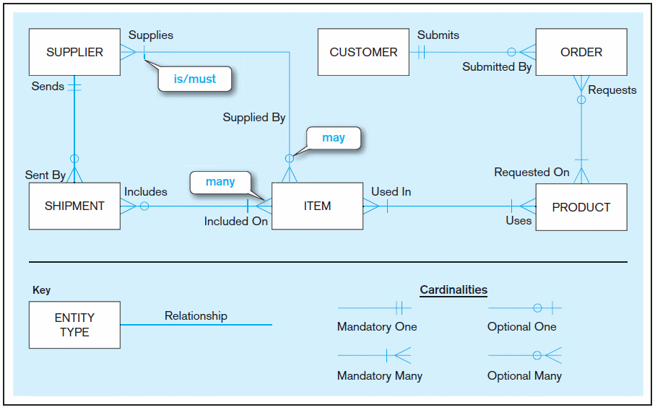
Sample E-R Diagram (Figure 2-1)
Notes:
3

Slide 3
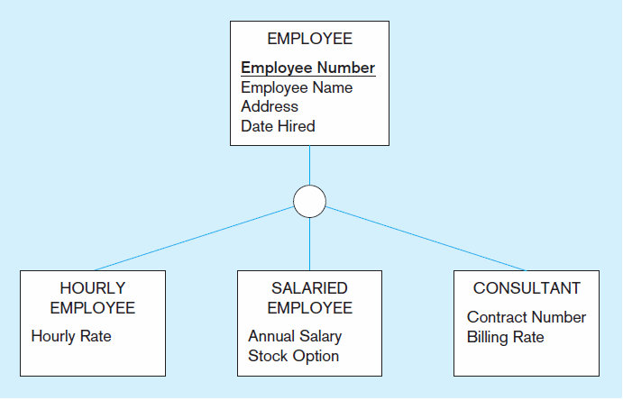
Figure 3-2 Employee supertype with three subtypes
All employee subtypes will have employee number, name, address, and date hired
Each employee subtype will also have its own attributes

Slide 4
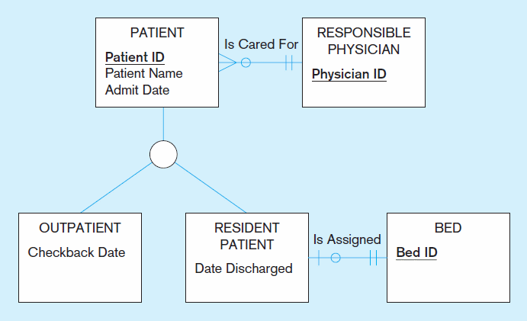
Figure 3-3 Supertype/subtype relationships in a hospital
Both outpatients and resident patients are cared for by a responsible physician
Only resident patients are assigned to a bed
Notes:
Both Residential and outpatient inherits the physician responsible

Slide 5
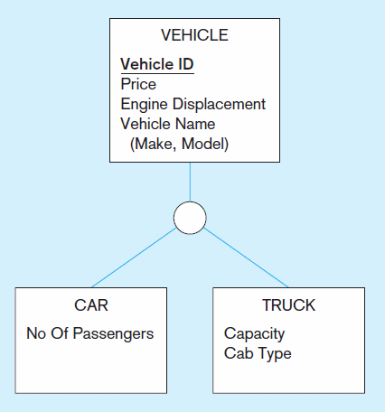
Figure 3-4 Example of generalization (cont.)
b) Generalization to VEHICLE supertype
So we put the shared attributes in a supertype
Note: no subtype for motorcycle, since it has no unique attributes
Notes:
Generalization -> top down approach !

Slide 6
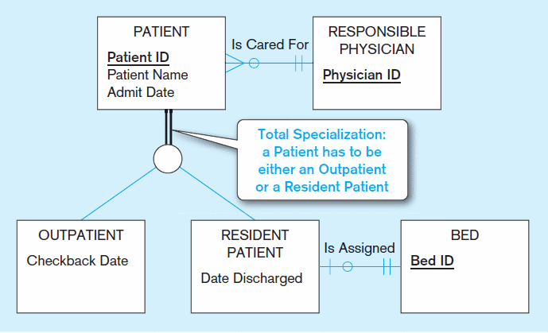
Figure 3-6 Examples of completeness constraints
a) Total specialization rule
Notes:
Completeness contains
Double line = Must exist in one of the subtype
Single Line = May or may not

Slide 7
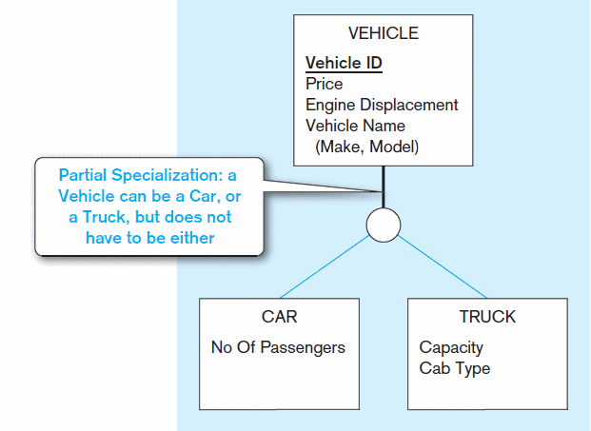
Figure 3-6 Examples of completeness constraints (cont.)
b) Partial specialization rule

Slide 8
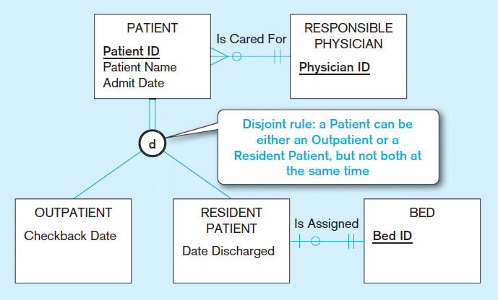
Figure 3-7 Examples of disjointness constraints
a) Disjoint rule
Notes:
Disjointness constraints
D = may be either one or the other, but not both

Slide 9
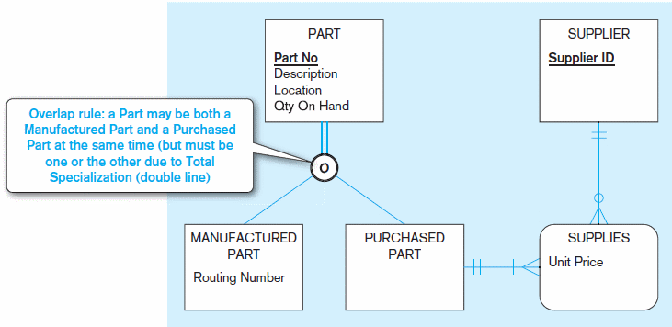
Figure 3-7 Examples of disjointness constraints (cont.)
b) Overlap rule
Notes:
Overlap -> self explanatory
A part may be one or the other, or both

Slide 10
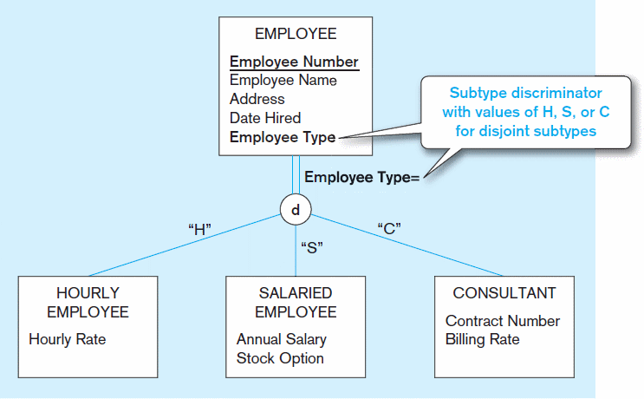
Figure 3-8 Introducing a subtype discriminator (disjoint rule)
Notes:
Subtype Discriminator = tells the model which subtype is used

Slide 11
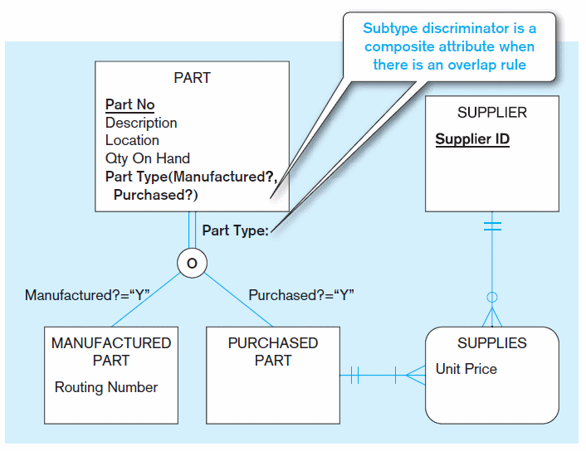
Figure 3-9 Subtype discriminator (overlap rule)
Notes:
Overlap discriminator with overlap -> implemented as Flags

Slide 12
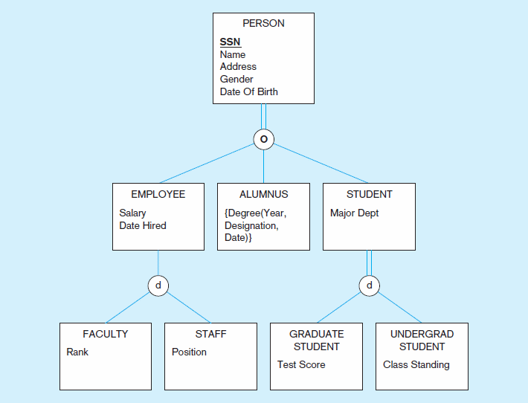
Figure 3-10 Example of supertype/subtype hierarchy
Notes:
There could be many levels of the hierarchy

Slide 13
Data Normalization
Primarily a tool to validate and improve a logical design so that it satisfies certain constraints that avoid unnecessary duplication of data
The process of decomposing relations with anomalies to produce smaller, well-structured relations
Notes:
Avoid data duplication -> it is a big problem at every company because data models often time are not properly design in many organizations.
Costs companies millions of dollars every year.
Well structure relations

Slide 14
Well-Structured Relations
A relation that contains minimal data redundancy and allows users to insert, delete, and update rows without causing data inconsistencies
Goal is to avoid anomalies
Insertion Anomaly–adding new rows forces user to create duplicate data
Deletion Anomaly–deleting rows may cause a loss of data that would be needed for other future rows
Modification Anomaly–changing data in a row forces changes to other rows because of duplication
General rule of thumb: A table should not pertain to more than one entity type
Notes:
Three anomalies to avoid:
Insertion Anomaly – creating duplicate records
Deletion Anomaly–deleting incorrect records, orphan records is an example of it
Modification Anomaly–force to change records multiple times. Think about change a customer name, should only be done once

Slide 15
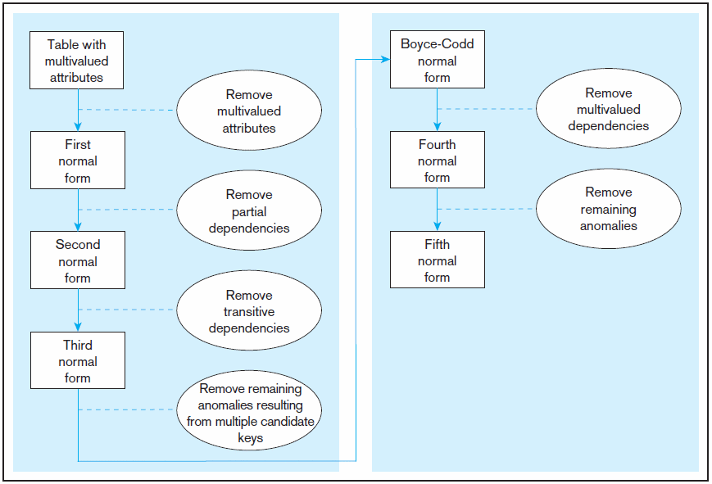
Figure 4.22 Steps in normalization
3rd normal form is generally considered sufficient
Notes:
Here are the steps to create normalizations:
1NF – remove multivalued attribute… Employee Skill for example
2NF – remove partial dependency
3NF – remove transitive dependencies
After 3NF it is typically not used. One interview question, you will often hear is “ Which Normal form do you normalize your database” The answer is third normal forms.

Slide 16
For each of the following relations, indicate the normal form for that relation. If the relation is not in third normal form, decompose it into 3NF relations. Functional dependencies (other than those implied by the primary key) are shown where appropriate.
CLASS(CourseNo, SectionNo)
CLASS(CourseNo, SectionNo, Room)
CLASS(CourseNo, SectionNo, Room, Capacity)
[FD: Room →Capacity]
CLASS(CourseNo, SectionNo, CourseName, Room, Capacity)
[FD: CourseNo →CourseName; FD: Room →Capacity]
Notes:
a)3NF
b)3NF
c) 2NF
CLASS (CourseNo, SectionNo, Room)
ROOM (Room, Capacity)
1NF
COURSE (CourseNo, CourseName)
CLASS (CourseNo, SectionNo, Room)
ROOM (Room, Capacity)

Slide 17
Choose Data Type
CHAR–fixed-length character
VARCHAR–variable-length character
LONG/BIGINT–large number
INT–positive/negative whole number
DATE–actual date
TIME – actual time
DATETIME – Date and time together
BLOB–binary large object (good for graphics, sound clips, etc.)

Slide 18
Methods to improve performance
Partitioning
Indexing
Writing efficient code
Overriding automatic query optimization

Slide 19
Rules for Indexes
Use on larger tables
Index the primary key of each table
Index search fields (fields frequently in WHERE clause)
Fields in SQL ORDER BY and GROUP BY commands

Slide 20
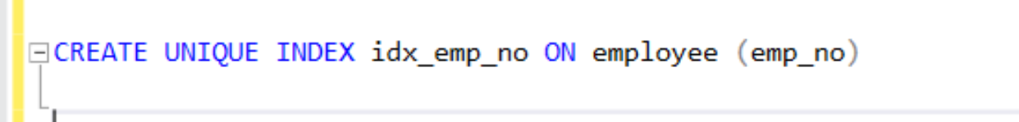
SYNTAX to create index
Create an Index on Unique column (no duplicate)
CREATE UNIQUE INDEX [IndexName] ON [TABLENAME] ([COLUMNNAME] )

Slide 21
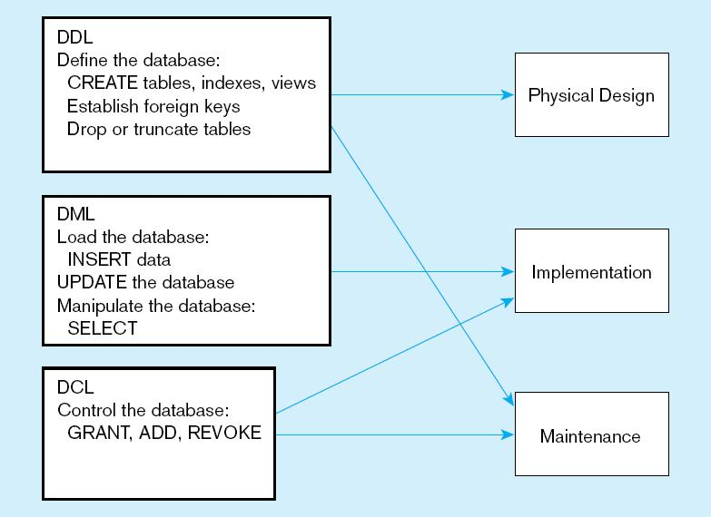
DDL, DML, DCL, and the database development process

Slide 22
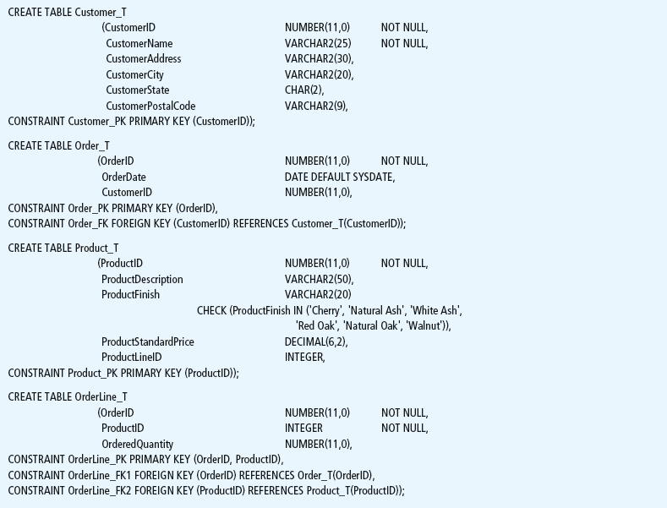

Slide 23
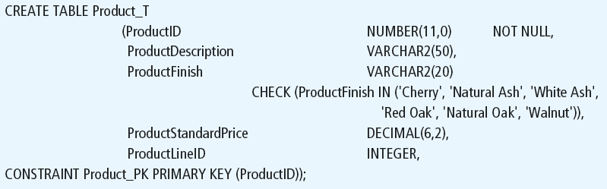
Defining attributes and their data types

Slide 24
Non-nullable specification
Primary keys can never have NULL values
Identifying primary key

Slide 25
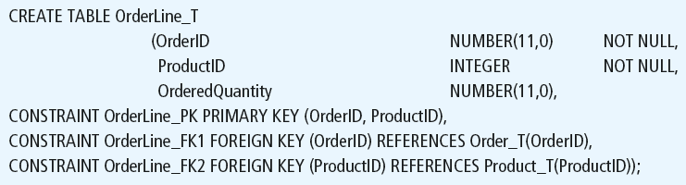
Non-nullable specifications
Primary key
Some primary keys are composite– composed of multiple attributes

Slide 26
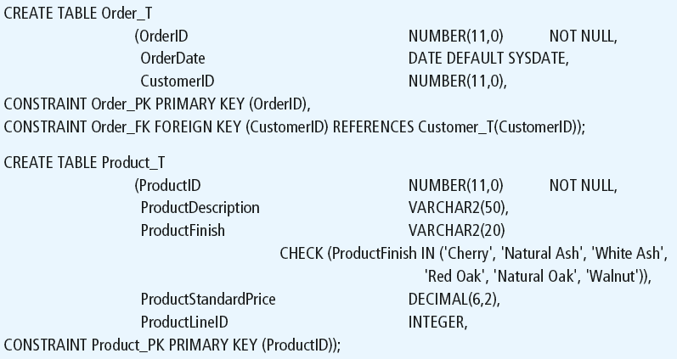
Controlling the values in attributes
Default value
Domain constraint

Slide 27
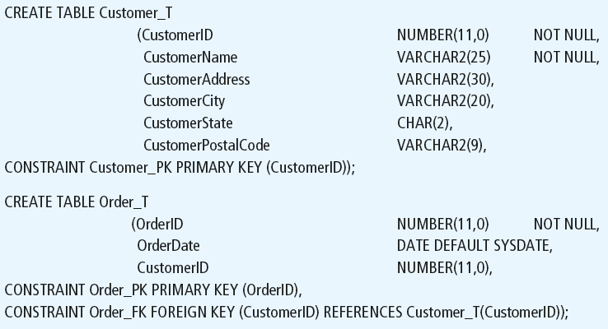
Identifying foreign keys and establishing relationships
Primary key of parent table
Foreign key of dependent table

Slide 28
Removing Tables
DROP TABLE statement allows you to remove tables from your schema:
DROP TABLE CUSTOMER_T

Slide 29



Insert Statement
Adds one or more rows to a table
Inserting into a table
Inserting a record that has some null attributes requires identifying the fields that actually get data
Inserting from another table
Notes:
Have students perform this function

Slide 30
Delete Statement
Removes rows from a table
Delete certain rows
DELETE FROM CUSTOMER_T WHERE CUSTOMERSTATE = ‘HI’;
Delete all rows
DELETE FROM CUSTOMER_T;

Slide 31

Update Statement
Modifies data in existing rows

Slide 32
SELECT Statement
Used for queries on single or multiple tables
Clauses of the SELECT statement:
SELECT
List the columns (and expressions) that should be returned from the query
FROM
Indicate the table(s) or view(s) from which data will be obtained
WHERE
Indicate the conditions under which a row will be included in the result
GROUP BY
Indicate categorization of results
HAVING
Indicate the conditions under which a category (group) will be included
ORDER BY
Sorts the result according to specified criteria

Slide 33
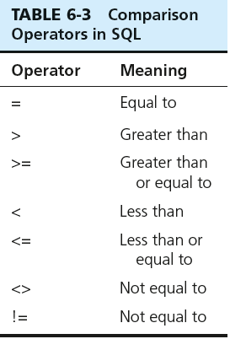

SELECT Example
Find products with standard price less than $275
Table 6-3: Comparison Operators in SQL
Notes:
Show the operators
Go back to SSMS and query the database!

Slide 34
SELECT Example Using Alias
Alias is an alternative column or table name
SELECT CUST.CUSTOMERNAME AS NAME, CUST.CUSTOMERADDRESS
FROM CUSTOMER_V CUST
WHERE NAME = ‘Home Furnishings’;

Slide 35
SELECT Example Using a Function
Using the COUNT aggregate function to find totals
SELECT COUNT(*) FROM ORDERLINE_T
WHERE ORDERID = 1004;
Note: with aggregate functions you can’t have single-valued columns included in the SELECT clause, unless they are included in the GROUP BY clause

Slide 36
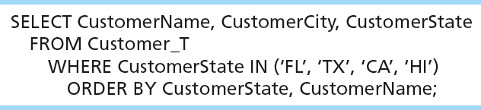
SELECT Example – Sorting Results with the ORDER BY Clause
Sort the results first by STATE, and within a state by the CUSTOMER NAME
Note: the IN operator in this example allows you to include rows whose CustomerState value is either FL, TX, CA, or HI. It is more efficient than separate OR conditions.

Slide 37
Aggregate Function syntax
SELECT expression1, expression2, ... expression_n,
aggregate_function1 (aggregate_expression),
aggregate_function2 (aggregate_expression)
FROM tables
[WHERE conditions]
GROUP BY expression1, expression2, ... expression_n
[ORDER BY expression [ ASC | DESC ]];
Notes:
Expression1 , 2 , 3 are non aggregates.
You may have more than one aggregate functions in a SELECT expression
All non aggregate expressions must included in the group by clause

Slide 38
Aggregate Functions
SUM -> summation
MIN -> to find the lowest or minimum
MAX -> to find the highest or maximum
AVG -> mean
COUNT -> how may records
Notes:
There are many others, depending on the DBMS system you are using.
STD Deviation of a population
STD Devation of a sample
VAR of Popluation
VAR of a population

Slide 39

SELECT Example– Categorizing Results Using the GROUP BY Clause
For use with aggregate functions
Scalar aggregate: single value returned from SQL query with aggregate function
Vector aggregate: multiple values returned from SQL query with aggregate function (via GROUP BY)
Note: you can use single-value fields with aggregate functions if they are included in the GROUP BY clause

Slide 40
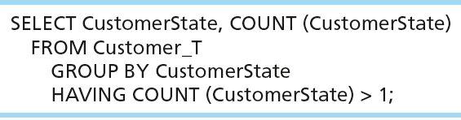
SELECT Example– Qualifying Results by Categories Using the HAVING Clause
For use with GROUP BY
Like a WHERE clause, but it operates on groups (categories), not on individual rows. Here, only those groups with total numbers greater than 1 will be included in final result.

Slide 41
SELECT DISTINCT
SELECT DISTINCT dept_id
FROM EMPLOYEE;
Results
Dept_id
500
501

Slide 42
SELECT DISTINCT in Aggregate Function
SELECT expression1, expression2, ... expression_n,
aggregate_function1 (DISTINCT aggregate_expression),
aggregate_function2 (aggregate_expression)
FROM tables
[WHERE conditions]
GROUP BY expression1, expression2, ... expression_n
[ORDER BY expression [ ASC | DESC ]];

Slide 43
Using and Defining Views
Views provide users controlled access to tables
Can be used for reporting
Base Table–table containing the raw data
Dynamic View
A “virtual table” created dynamically upon request by a user
No data actually stored; instead data from base table made available to user
Based on SQL SELECT statement on base tables or other views
Notes:
Materialized views in Oracle, they are called Indexed views in SQL Server which are based on clustered index

Slide 44
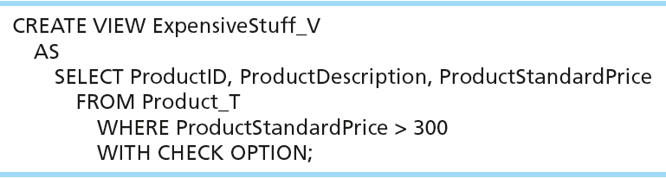
Sample CREATE VIEW
View has a name
View is based on a SELECT statement
Notes:
Materialized views

Slide 45
Advantages of Views
Simplify query commands
Assist with data security (but don't rely on views for security, there are more important security measures)
Enhance programming productivity
Contain most current base table data
Use little storage space
Provide customized view for user
Establish physical data independence

Slide 46
Multiple Table processing
JOINS

Slide 47
Practical Version: Four Types of JOINS
INNER JOIN
OUTER JOIN
LEFT OUTER JOIN
RIGHT OUTER JOIN
FULL JOIN

Slide 48
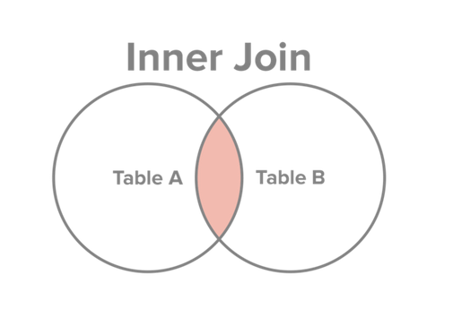
INNER JOIN
Select all records from Table A and Table B, where the join condition is met.
http://www.sql-join.com/sql-join-types/

Slide 49
INNER JOIN SQL
SELECT c. CustomerID, c.CustomerName, o.OrderID
FROM Customer_T c INNER JOIN ORDER_T AS o ON c.CustomerID = o.CustomerID
Key word INNER is optional:
SELECT c. CustomerID, c.CustomerName, o.OrderID
FROM Customer_T c JOIN ORDER_T AS o ON c.CustomerID = o.CustomerID
Notes:
This query returns only customers that have orders,
If a customer doesn’t have orders it doesn’t show up

Slide 50
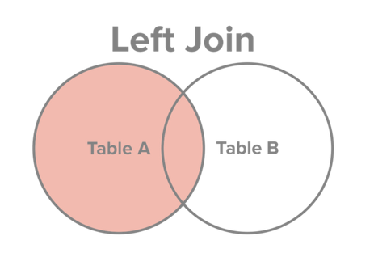
JOINS: LEFT OUTER JOIN
Select all records from Table A, along with records from Table B for which the join condition is met (if at all).
http://www.sql-join.com/sql-join-types/

Slide 51
LEFT OUTER JOIN SQL
SELECT c. CustomerID, c.CustomerName, o.OrderID
FROM Customer_T c LEFT OUTER JOIN ORDER_T AS o ON c.CustomerID = o.CustomerID
Key word OUTER is optional:
SELECT c. CustomerID, c.CustomerName, o.OrderID
FROM Customer_T c LEFT JOIN ORDER_T AS o ON c.CustomerID = o.CustomerID
Notes:
This query returns only customers that have orders,
If a customer doesn’t have orders it doesn’t show up

Slide 52
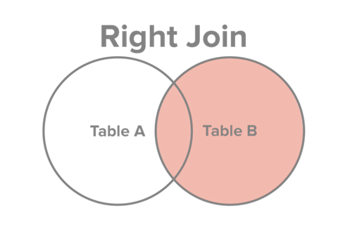
JOINS: RIGHT OUTER JOIN
Select all records from Table B, along with records from Table A for which the join condition is met (if at all).
http://www.sql-join.com/sql-join-types/

Slide 53
RIGHT OUTER JOIN SQL
SELECT c. CustomerID, c.CustomerName, o.OrderID
FROM Order_T o RIGHT OUTER JOIN Customer_T c ON c.CustomerID = o.CustomerID
Key word OUTER is optional:
SELECT c. CustomerID, c.CustomerName, o.OrderID
FROM Order_T o RIGHT JOIN Customer_T c ON c.CustomerID = o.CustomerID
Notes:
This query returns only customers that have orders,
If a customer doesn’t have orders it doesn’t show up

Slide 54
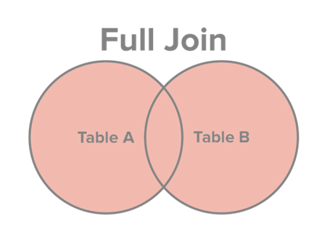
JOINS: FULL JOIN
Select all records from Table A and Table B, regardless of whether the join condition is met or not.
http://www.sql-join.com/sql-join-types/

Slide 55
FULL JOIN SQL
SELECT c. CustomerID, c.CustomerName, o.OrderID
FROM Customer_T c FULL JOIN ORDER_T AS o ON c.CustomerID = o.CustomerID
Notes:
This query returns only ORDERS orders,
If a customer doesn’t have orders it doesn’t show up

Slide 56
Multiple Table JOIN
SELECT c.CustomerID, c.CustomerName, c.CustomerAddress, c.CustomerCity, c.CustomerState, c.CustomerPostalCode, o.OrderID, o.OrderDate, ol.OrderedQuantity, p.ProductDescription, p.StandardPrice, ( ol.OrderedQuantity*p.ProductStandardPrice)
FROM Customer_T c JOIN Order_T o ON c.CustomerID = o.CustomerID
JOIN OrderLine_T ol ON o.OrderID = ol.OrderID
JOIN Product_T p ON ol.ProductID = p.ProductID
WHERE o.OrderID = 1006

Slide 57
Multiple Table processing
SUBQUERY

Slide 58
Processing Multiple Tables Using Subqueries
Subquery–placing an inner query (SELECT statement) inside an outer query
Options:
In a condition of the WHERE clause
As a “table” of the FROM clause
Within the HAVING clause
In the SELECT clause
Subqueries can be:
Noncorrelated–executed once for the entire outer query
Correlated–executed once for each row returned by the outer query
Notes:
We covered using join to process multiple tables. Another way is through use of subqueries.
Subquery is as the name suggests a query within the query.
Subquery can be placed in “
SELECT clause
FROM Caluse
HAVING clause
Two types:
Correlated – needs a link between the outer query and the subquery -> executes for each row returned in the query
Non-correlated – there is on inner link in the subquery. Executes once

Slide 59
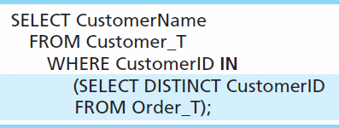
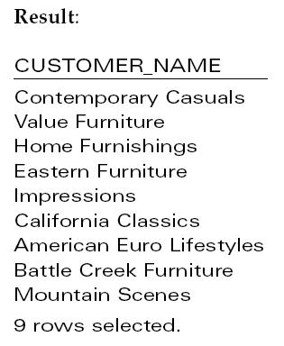
Subquery Example
Show all customers who have placed an order
The IN operator will test to see if the CUSTOMER_ID value of a row is included in the list returned from the subquery
Subquery is embedded in parentheses. In this case it returns a list that will be used in the WHERE clause of the outer query
Notes:
Subquery is what is in parenthesis.
In this example, the subquery can run by itself and return a result. Subquery is always in parenthesis
The subquery will return a list of all distinct or unique customer ID, and then that result is used to filter the outer query
This is a non-correlated subquery

Slide 60
Correlated vs. Noncorrelated Subqueries
Noncorrelated subqueries:
Do not depend on data from the outer query
Execute once for the entire outer query
Correlated subqueries:
Make use of data from the outer query
Execute once for each row of the outer query
Can use the EXISTS operator
Notes:
Noncorrelated subqueries:
Do not depend on data from the outer query – just like we saw in the prior example the subquery could run by itself and you will see a list of customer ids
Execute once for the entire outer query – only executves
Correlated subqueries:
Make use of data from the outer query
Execute once for each row of the outer query

Slide 61
Correlated Subquery Example
Show all orders that include furniture finished in natural ash
SELECT DISTINCT OrderID FROM OrderLine_T
WHERE EXISTS
(SELECT * FROM Product_T
WHERE ProductID = OrderLine_T.ProductID
AND Productfinish = ‘Natural ash’);
The EXISTS operator will return a TRUE value if the subquery resulted in a non-empty set, otherwise it returns a FALSE
The subquery is testing for a value that comes from the outer query
➔ A correlated subquery always refers to an attribute from a table referenced in the outer query
Notes:
The EXISTS operator will return a TRUE if there is any result (non empty) , or a value of false if NOTHING was found. Empty result
A correlated subquery always refers to an attribute from a table referenced in the outer query. In this case ProductID
Matching fields from the outer query with fields from the subquery

Slide 62
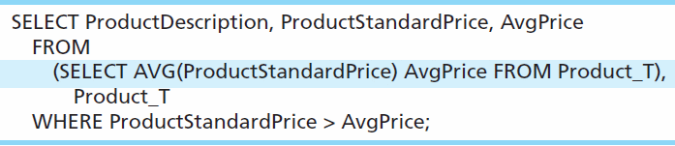
Another Subquery Example
Show all products whose standard price is higher than the average price
One column of the subquery is an aggregate function that has an alias name. That alias can then be referred to in the outer query
Subquery forms the derived table used in the FROM clause of the outer query
The WHERE clause normally cannot include aggregate functions, but because the aggregate is performed in the subquery its result can be used in the outer query’s WHERE clause
Notes:
In this query the subquery is in the FROM clause – this forms a derived table…
Average price is an alias of the aggregate function Now we can filter by it

Slide 63
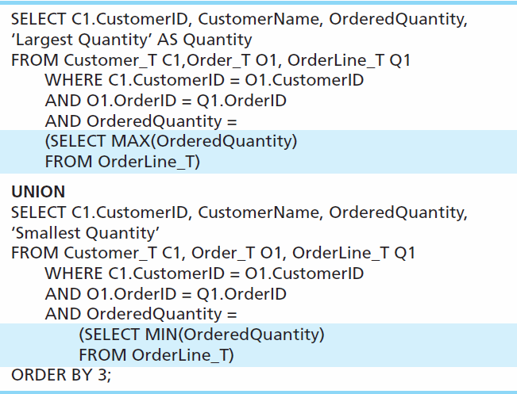
Union Queries
Combine the output (union of multiple queries) together into a single result table ( NO DUPS
First query
Combine
Second query
Notes:
UNION is used to combined output of multiple queries. Several times instead of writing one complicated query, it is easier and more readable to write two queries and combine the results.
That’s what union does

Slide 64
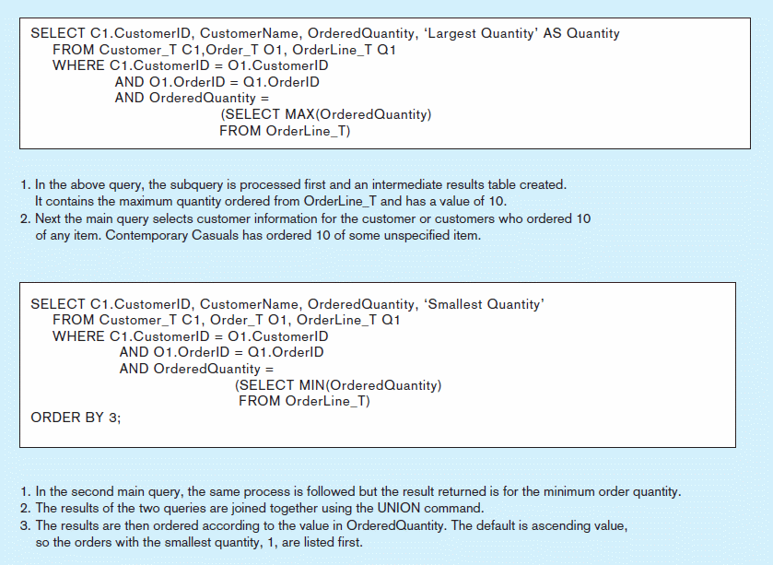
Figure 7-8 Combining queries using UNION
Note: with UNION queries, the quantity and data types of the attributes in the SELECT clauses of both queries must be identical
Notes:
When you union,
Data Types need to match, and the number of fields also have to match

Slide 65
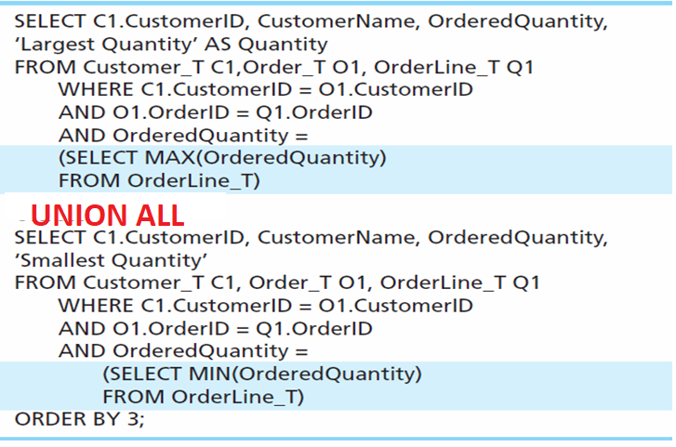
Union ALL Queries
Combine the output (union of multiple queries) together into a single result table ( WITH DUPS)
First query
Combine
Second query

Slide 66
Persistent Stored Module (PSM)
Persistent Stored Modules (SQL/PSM)
Capability to create and drop code modules
New statements:
CASE, IF, LOOP, FOR, WHILE, etc.
Makes SQL into a procedural language
Oracle has propriety version called PL/SQL, and Microsoft SQL Server has Transact/SQL

Slide 67
Routines and Triggers
Routines
Program modules that execute on demand
Functions–routines that return values and take input parameters
Procedures–routines that do not return values and can take input or output parameters
Triggers–routines that execute in response to a database event (INSERT, UPDATE, or DELETE)
Notes:
Routine is a block of code that does something, much like other programing languages such as java or C++
The tools available in those languages are also available in databases.
There is 3 basic types of routines in the database world:
Function, routine that takes input values and return values back
Stored procedures – returns that cannot return values but take input parameters
Triggers – routines that execute when an even occurs! For example a delete of a table

Slide 68
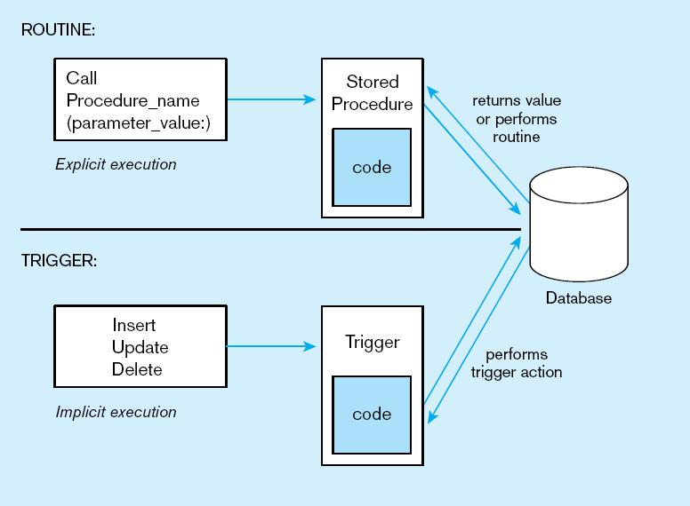
Figure7-11Triggers contrasted with stored procedures
Procedures are called explicitly
Triggers are event-driven
Source: adapted from Mullins, 1995.
Notes:
Procedures are called explicitly.
Functions are called when a DML statement is executed

Slide 69
Example of SQL Server Stored Procedures
CREAE PROCEDURE ChangeEmployeeDept @emp_no INT, @new_depar_no varchar(5)
AS
BEGIN
UPDATE employee set dept_no =@new_depar_no
WHERE emp_no = @emp_no
END
/*Executing the stored procedure */
EXEC ChangeEmployeeDept @emp_no= 15000, @new_depar_no='D1'
Notes:
ALTER PROCEDURE GetEmployees @depar_no varchar(5)
AS
BEGIN
SELECT * FROM employee
WHERE dept_no =@depar_no
END
EXEC GetEmployees 'D1’
ALTER PROCEDURE ChangeEmployeeDept @emp_no INT, @new_depar_no varchar(5)
AS
BEGIN
UPDATE employee set dept_no =@new_depar_no
WHERE emp_no = @emp_no
END
EXEC ChangeEmployeeDept 15000, 'D1’
EXEC ChangeEmployeeDept @emp_no= 15000, @new_depar_no='D1'

Slide 70
Stored Procedure with Output Parameter
CREATE PROCEDURE GetMinEmployee @MinEmployeeNo int OUTPUT
AS begin
select @MinEmployeeNo =min(emp_no)
from employee
end
/* How to Execute a stored proc with output parameter*/
declare @MinEmployeeNo int
EXEC GetMinEmployee @MinEmployeeNo output
select @MinEmployeeNo

Slide 71
Concurrency Control
TRANSACTIONS

Slide 72
Transaction
BEGIN TRANSACTION
insert into department ( dept_no, dept_name)
values ( 'D6', 'Support')
SAVE TRANSACTION a
insert into department ( dept_no, dept_name)
values ( 'D7', 'Research')
SAVE TRANSACTION b
insert into department ( dept_no, dept_name)
values ( 'D8', 'Management')
ROLLBACK TRANSACTION b
insert into department ( dept_no, dept_name)
values ( 'D8', 'Sales')
ROLLBACK TRANSACTION a
COMMIT TRANSACTION;

Slide 73
Exam Format
You will be presented with a data model with sample record and be asked to write SQL statements against the data the data model.

Slide 74
Incorrect SQL, you need to rewrite
SELECT dept_no, count(*)
FROM employee
GROUP BY dept_no
WHERE count(*)> 2
ORDER BY count(*)

Slide 75
DISTINCT/ UNION/ UNION ALL
SELECT DISTINCT dept_no FROM employee
SELECT ….
FROM TABLE
UNION [ALL]
SELECT …
FROM TABLE

Slide 76
Aggregate Functions
COUNT, MAX, AVG, MIN
SELECT count(*), count(location) FROM [dbo].[department]

Slide 77
Aggregate Functions and Subquery
Output projects with budgets < than average
select *
from [project]
where budget <
( select AVG(budget) from project
)

Slide 78
Concepts to know
Normalization
Denormalization
Partitioning
Horizontal
Vertical

Slide 79
EER – Supertype and Subtype

Slide 80
DELETE
DELETE a record from project table with the smallest budget:
DELETE FROM [project]
where budget >
( select MIN(budget) from project
)

Slide 81
Filtering on Aggregates
HAVING clause
select project_no, AVG(budget)
FROM project
GROUP BY project_no
HAVING AVG(budget)> 303750

Slide 82
ISOLATION Levels
READ UNCOMITTED
READ COMMITED
REPETABLE READ
SNAPSHOT
SERIALIZABLE

Slide 83
SQL string manipulation

Slide 84
CREATE VIEW

Slide 85
NORMALIZATION
Third Normal Form

Slide 86
DDLs
ALTER TABLE
ADD a new column
Remove a column
Add a FK to reference another table
DROP TABLE
CREATE INDEX
CREATE TABLE

Slide 87
Operational System vs. Decision Support

Slide 88
TRANSACTIONS
BEGIN TRANSACTION
UPDATE 1
INSERT 2
ROLLBACK
UPDATE 3
COMMIT;

Slide 89
Locks in Pessimistic Model
Share Lock
Exclusive Lock
Update Locks

